Slide 1
NYSED Science Update
Middle Level Liaisons Conference
May 2022
Notes:
NYSED Science Update
Welcome and good morning! My name is Nicole Marschilok and I am an Associate in Instructional Services for science in the Office of Standards and Instruction. I will be providing an update today that summarizes information and new resources related to science curriculum and instruction. My goal today is to familiarize you with:
Newly released Turnkey Guides and the NYSP12SLS Quick Guide document.
To make you aware of the free science resources available on the NYSED Science website.
To illustrate some of the helpful science links for educators and administrators.

Slide 2
Agenda
Welcome and Introduction
Introduction to the NYSED Science Page
Introduction to the New York State P12 Science Learning Standards Quick Guide
Introduction to the Science Turnkey Guides
Closing and
Thank you!
Updates from NYSED
Notes:
Agenda
The agenda today is as followed:
Welcome!
Quick updates from OSA
Introduction to the NYSED Science Page
Introduction to the New York State P12 Science Learning Standards Quick Guide
Science Standards Scavenger Hunt!
Introduction to the Science Turnkey Guides
Closing and Thank you!

Slide 3
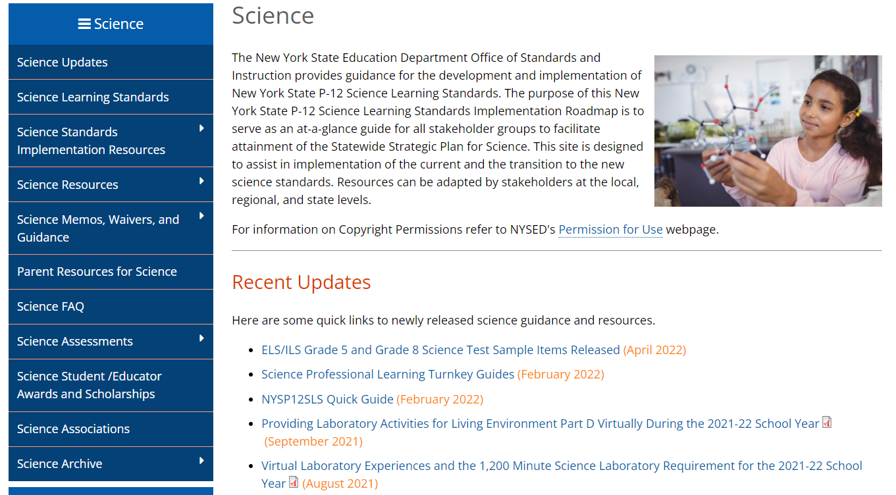
NYSED Standards And Instruction Science Page
Notes:
NYSED Curriculum and Instruction Science Website
The Office of Standards and Instruction asks all PK-12 educators of science, as well as school and district leaders, especially in science leadership positions to visit the NYSED’s Science page for valuable information and resources to assist and support in state-wide, regional, and local implementation efforts of the New York State P-12 Science Learning Standards.
Orange Arrow: On the front-page Recent Updates are listed. Its an easy and convenient way to stay up to date with the latest updates.
Yellow Arrow: Updated Science Implementation resources such as State Science Resource Network and Interactive Map, the link to the Integrating Science and Language for All Students with a Focus on English Language Learners webinars and briefs which support equitable access to the NYS P-12 Science Learning Standards for English Language Learners and Multilingual Learners.
Green Arrow: A new section entitled ‘Science Memos, Waivers and Guidance” has been created to help organized these frequently asked for documents in one convenient location.

Slide 4
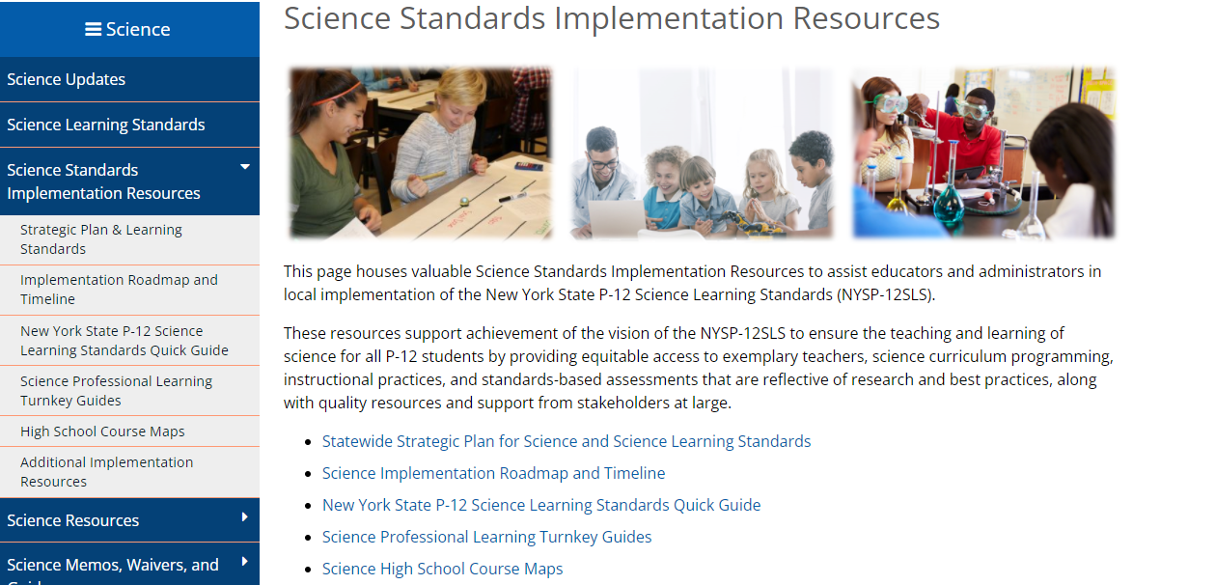
Notes:
Science Standards Implementation Resources page
Our new Science Standards Implementation Resources page has just been published. This page houses valuable resources to help with the implementation process including:
Statewide Strategic Plan for Science and Science Learning Standards
Science Implementation Roadmap and Timeline
New York State P-12 Science Learning Standards Quick Guide
Science Professional Learning Turnkey Guides
Science High School Course Maps
Additional Science Standards Implementation Resources

Slide 5
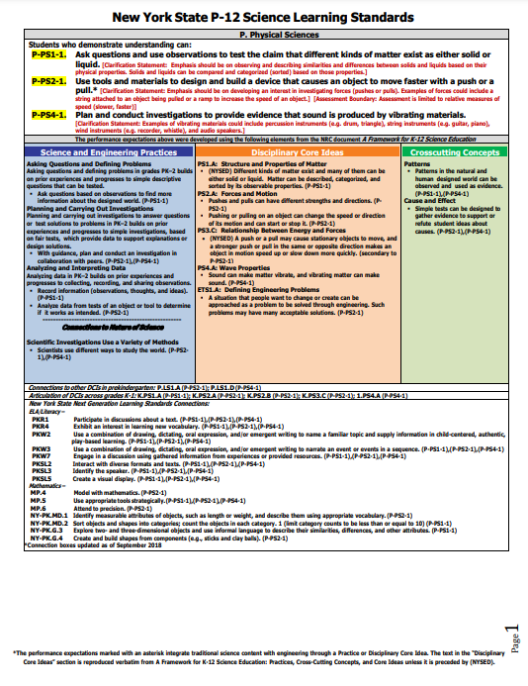
MST to NYSP12SLS
Notes:
In order to talk about our new science standards, we need to acknowledge the standards we have been using. New York State adopted the Learning Standards for Mathematics, Science and Technology (MST) in 1996. After 20 years of using the MSTs in New York State classrooms, in 2016, the New York State Board of Regents adopted the New York State P-12 Science Learning Standards.
A common misconception is that the New York State P-12 Science Learning Standards or NYSSLS is NGSS. The NYSSLS are based on the NGSS but with variations and additions.
The New York State P-12 Science Learning Standards are a series of performance expectations that define what students should understand and be able to do as a result of their study of science. The New York State P-12 Science Learning Standards are based on the Framework for K–12 Science Education developed by the National Research Council and the Next Generation Science Standards.
The NYSP-12SLS are based on guiding documents grounded in the most current research in science and scientific learning; and reflect the importance of every student’s engagement with natural scientific phenomenon at the nexus of three dimensions of learning; Science and Engineering Practices, Disciplinary Core Ideas, and Crosscutting concepts.
Twenty states and the District of Columbia (representing over 36% of U.S. students) have adopted the Next Generation Science Standards (NGSS).
Like New York State, twenty-four states (representing 35% of U.S. students) have developed their own standards based on recommendations in the NRC Framework for K-12 Science Education.

Slide 6
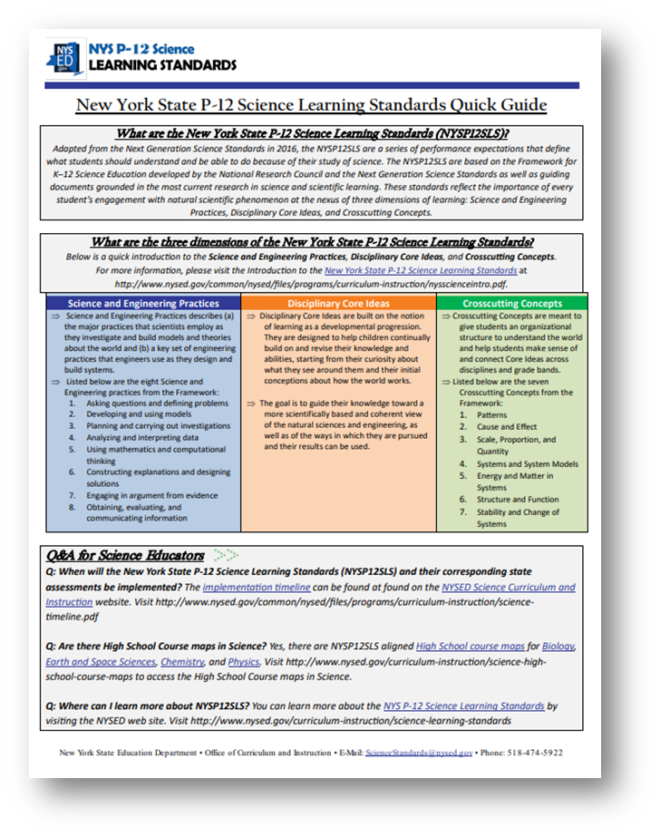
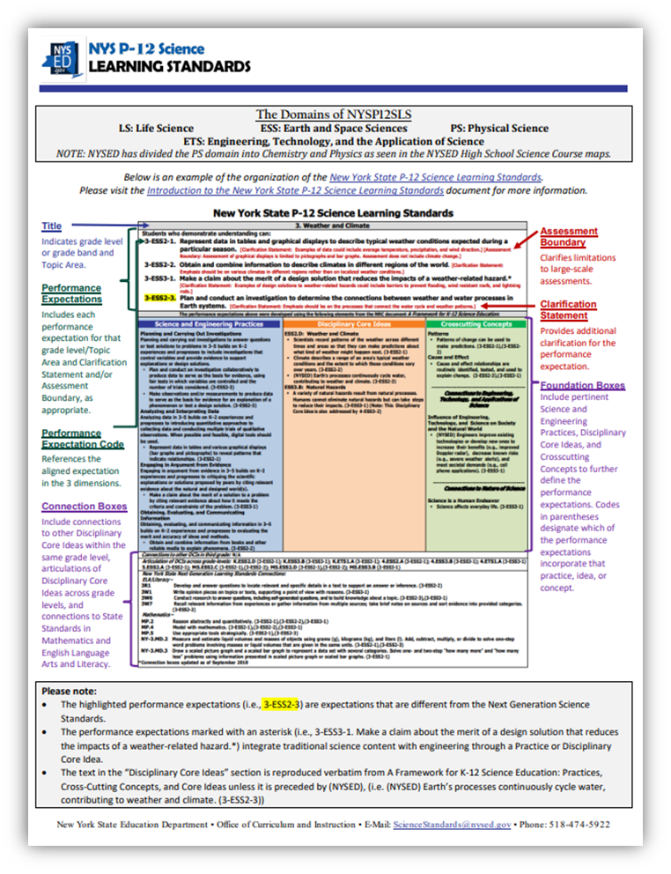
New York State P-12 Science Learning Standards Quick Guide
Notes:
New York State P12 Science Learning Standards Quick Guide
The first resource I am going to introduce you to today is the New York State P12 Science Learning Standards Quick Guide. This guide was created to help educators and administrators understand the construction of the new standards. It is recommended that this document be printed front to back, in color, due to the importance of the color labels.

Slide 7
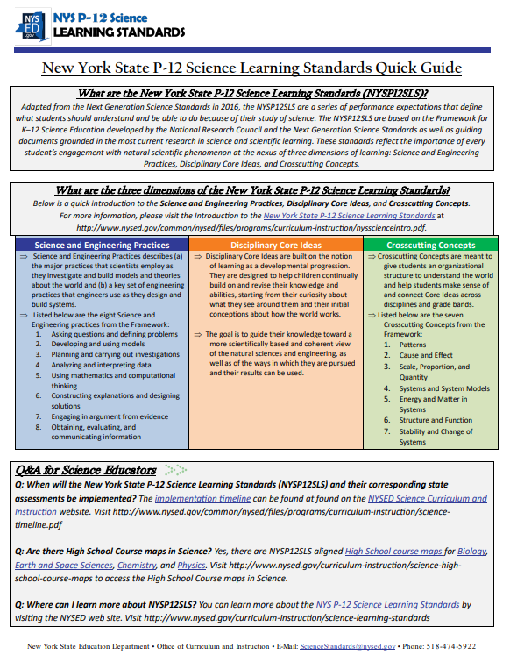
A breakdown of the three dimensions of the NYSP12SLS
Frequently Asked Questions about the NYSP12SLS
Notes:
New York State P12 Science Learning Standards Quick Guide
The first resource I am going to introduce you to today is the New York State P12 Science Learning Standards Quick Guide. When I asked to create the document, it was based on my experience as a first-year teacher…
Adapted from the Next Generation Science Standards in 2016, the NYSP12SLS are a series of performance expectations that define
what students should understand and be able to do because of their study of science.
The NYSP12SLS are based on the Framework for K–12 Science Education developed by the National Research Council and the Next Generation Science Standards as well as guiding documents grounded in the most current research in science and scientific learning.
These standards reflect the importance of every student’s engagement with natural scientific phenomenon at the nexus of three dimensions of learning: Science and Engineering Practices, Disciplinary Core Ideas, and Crosscutting Concepts.
Twenty states and the District of Columbia (representing over 36% of U.S. students) have adopted the Next Generation Science Standards (NGSS).
Like New York State, twenty-four states (representing 35% of U.S. students) have developed their own standards based on recommendations in the NRC Framework for K-12 Science Education.
(Nicole will break down the document)

Slide 8
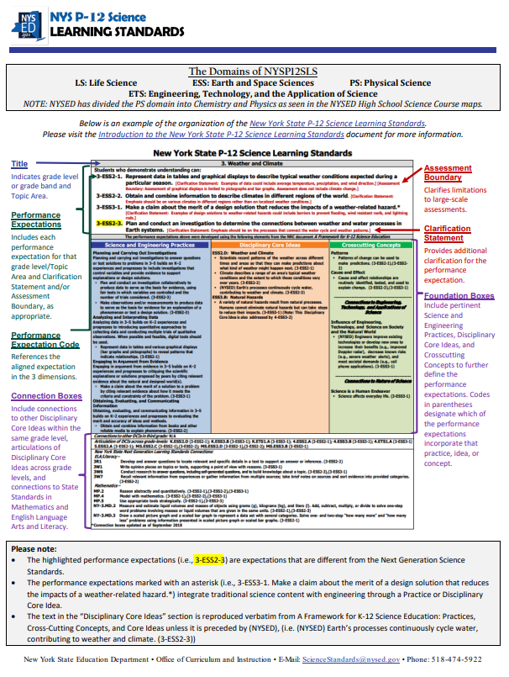
Definitions of the structure of the standards
are provided.
Special codes and notations found are defined in one spot.
Notes:
New York State P12 Science Learning Standards Quick Guide
(Nicole will break down the document)
Mention: Titles and GRADE BANDS
Mention: NOT standard but PE
It is recommended that this document be printed front to back, in color, due to the importance of the color labels.

Slide 9
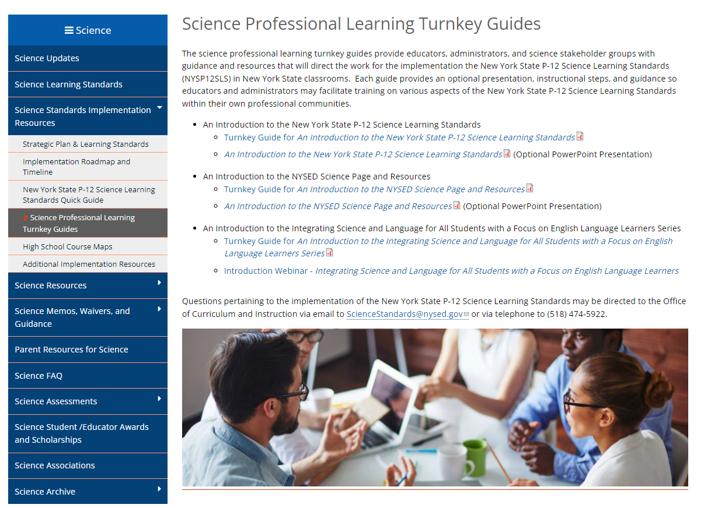
Notes:
Science Professional Learning Turnkey Guide page
Housed within the Science Standards Implementation Resources page is the Science Professional Learning Turnkey Guide page created for the field this year. This page houses three turnkey guides and optional PowerPoint presentations that were created for professional development opportunities. Each guide provides an optional presentation, instructional steps, and guidance so educators and administrators may facilitate training on various aspects of the New York State P-12 Science Learning Standards within their own professional communities. They are titled:
An Introduction to the New York State P-12 Science Learning Standards
Turnkey Guide for An Introduction to the New York State P-12 Science Learning Standards
An Introduction to the New York State P-12 Science Learning Standards (Optional PowerPoint Presentation)
An Introduction to the NYSED Science Page and Resources
Turnkey Guide for An Introduction to the NYSED Science Page and Resources
An Introduction to the NYSED Science Page and Resources (Optional PowerPoint Presentation)
An Introduction to the Integrating Science and Language for All Students with a Focus on English Language Learners Series
Turnkey Guide for An Introduction to the Integrating Science and Language for All Students with a Focus on English Language Learners Series
Introduction Webinar - Integrating Science and Language for All Students with a Focus on English Language Learners
We will be talking about them further later in the presentation.

Slide 10
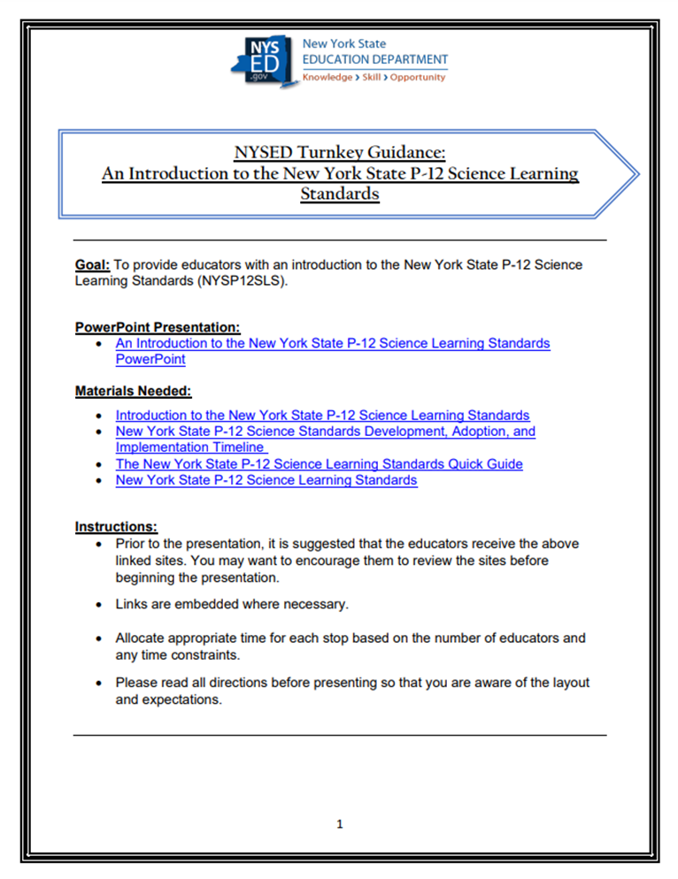
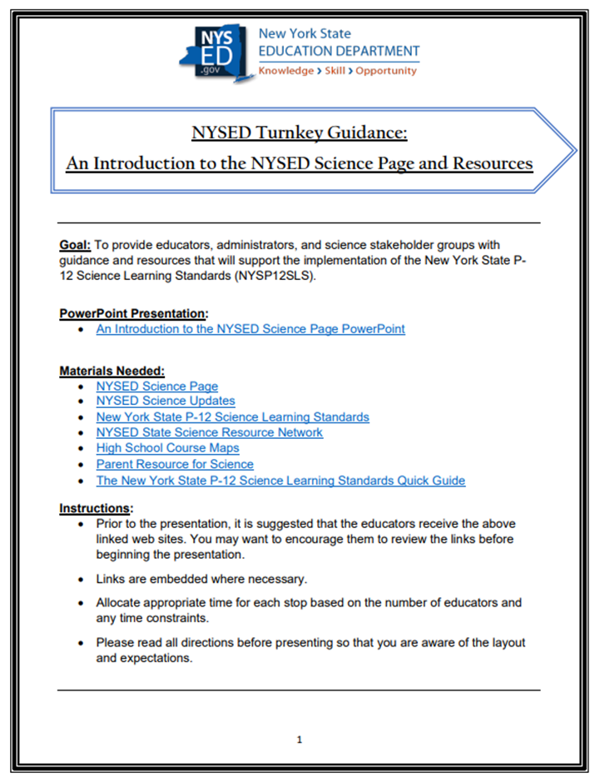
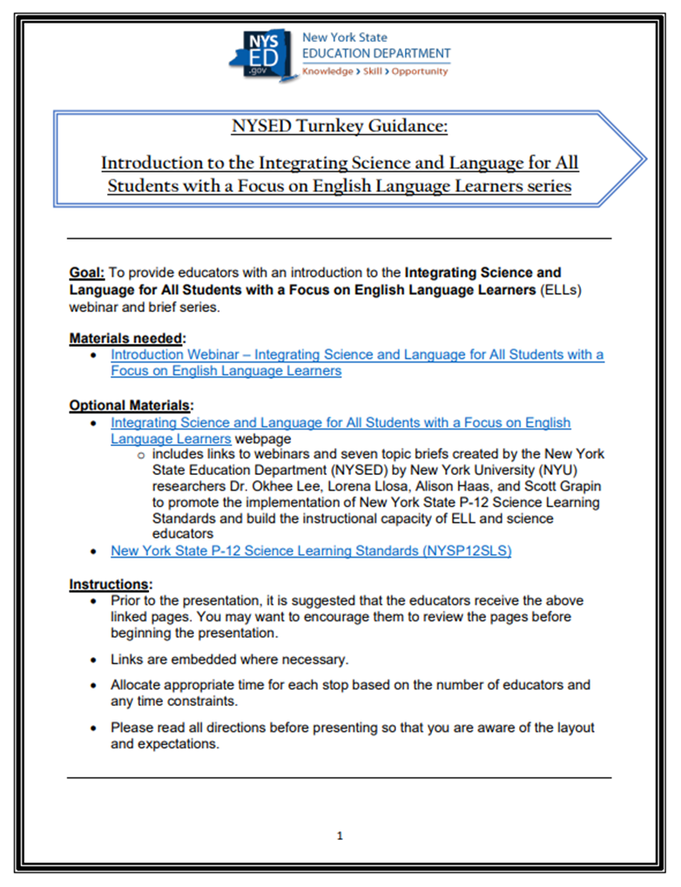
New Science Turnkey Guides
Notes:
New Science Turnkey Guides
CLICK TIMES THREE
These guides provide educators, administrators, and science stakeholder groups with guidance and resources that will direct the work for the implementation the New York State P-12 Science Learning Standards (NYSP12SLS) in New York State classrooms.
The turnkey guides are:
An Introduction to the New York State P-12 Science Learning Standards
Turnkey Guide for An Introduction to the New York State P-12 Science Learning Standards
An Introduction to the New York State P-12 Science Learning Standards (Optional PowerPoint Presentation)
An Introduction to the NYSED Science Page and Resources
Turnkey Guide for An Introduction to the NYSED Science Page and Resources
An Introduction to the NYSED Science Page and Resources (Optional PowerPoint Presentation)
An Introduction to the Integrating Science and Language for All Students with a Focus on English Language Learners Series
Turnkey Guide for An Introduction to the Integrating Science and Language for All Students with a Focus on English Language Learners Series
Introduction Webinar - Integrating Science and Language for All Students with a Focus on English Language Learners

Slide 11
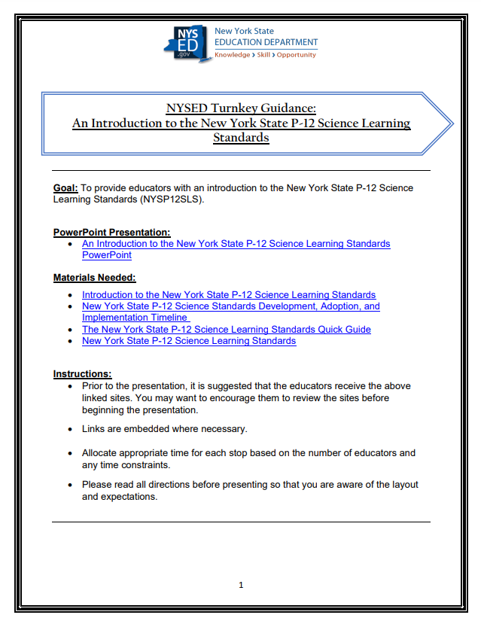
Notes:
An Introduction to the New York State P-12 Science Learning Standards Turnkey Guide
Our first turnkey guide is called “An Introduction to the New York State P-12 Science Learning Standards.” This document was created to help guide educators through the creation and adoption process to the implementation of the new science standards. Using independent and group activities embedded with live links to our NYSED Science webpage, this turnkey guide gives educators and administrators a deeper drive into the standards.
Sections included:
1: Introduction to the Standards
2: The Three Dimensions
3: The Organization of the NYSP12SLS
4: Implementation Timeline and Quick Guide
5: Connecting to the Performance Expectations
An optional PowerPoint resource compliments the Turnkey Guide at every STOP in the session.

Slide 12
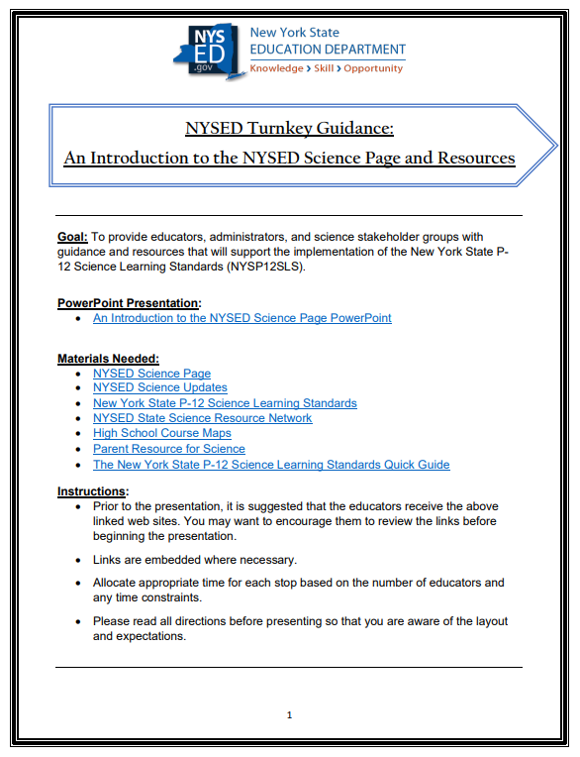
Notes:
An Introduction to the Office of Curriculum and Instruction Science Page Turnkey Guide
The second turnkey guide released is titled “An Introduction to the Office of Curriculum and Instruction Science Page”. This guide provide educators, administrators, and science stakeholder groups with guidance and resources that will support the implementation of the New York State P12 Science Learning Standards (NYSP12SLS). As with the previous guide, this professional development tool is embedded with live links guiding the attendee through our NYSED science page.
Sections included are:
Stop 1: The New York State Education Department’s Science Page
Stop 2: High School Course Maps
Stop 3: Other NYSED Science Resources
This turnkey guide also comes with a PowerPoint that helps the presentor facilitate discussions and group activities that will give attendees the tools needed for the implementation process.

Slide 13
Notes:
Introduction to the Integrating Science and Language for All Students with a Focus on English Language Learners Series Turnkey Guide
The final turkey guide is titled “Introduction to the Integrating Science and Language for All Students with a Focus on English Language Learners Series”. The goal of this guide is to provide educators with an introduction to the Integrating Science and Language for All Students with a Focus on English Language Learners (ELLs)
webinar and brief series created by the New York State Education Department (NYSED) and by New York University (NYU) researchers Dr. Okhee Lee, Lorena Llosa, Alison Haas, and Scott Grapin to promote the implementation of New York State P-12 Science Learning Standards and build the instructional capacity of ELL and science educators. The seven webinars and topic briefs can be found on the New York State Education Department Office of Bilingual Education and World Languages (OBEWL) web site.
Sections include:
Stop 1: The New York State P-12 Science Learning Standards
Stop 2: The Purpose of the Webinars and Briefs
Stop 3: Overview of Series
Stop 4: Brief Review
Stop 5: Summation
Included is the Introduction Webinar - Integrating Science and Language for All Students with a Focus on English Language Learners narrated by Dr. Okhee Lee.

Slide 14
Science Implementation Timeline Map
Notes:
Science Implementation Timeline Map – Updated April 2021
The Implementation Science Timeline map was updated again and released April 14, 2021;
It provides a snapshot with important milestones for development of standards, new science assessments, and transitions for curriculum programming and instruction, as well as new established dates for the first administration of new elementary, intermediate levels and HS science assessments.
The overall timeline for the implementation of the NYS P-12 Science Learning Standards is now as follows: • Phase I: Raise Awareness and Build Capacity (Summer 2017-Summer 2019) • Phase II: Transition and Implementation (September 2019-Summer 2023) • Phase III: Implementation and Sustainability (September 2023 – ongoing(thru)2026

Slide 15
NYS P-12 Science Learning Standards Implementation Roadmap
Notes:
NYSP12SLS Implementation ROADMAP
The “Roadmap” provides a recommended plan and/or process spread-over several years that highlights shared goals, objectives, and activities to support the NYS Education Department, local school districts, and other key stakeholders with the transition and full implementation to the NYS P-12 Science Learning Standards. Districts are encouraged to tailor the suggested implementation activities and develop specific actions designed to meet district level needs during the transition process.
Science Implementation Roadmap document provides an overview section of what to expect in each ‘phase' of implementation. Pages 3-9 includes all phases of implementation and signals where districts can gage their implementation process at any given time.
The remainder of the document provides a template that incudes each phase of the implementation process that districts, schools, and educators can utilize for planning and documenting their local implementation progress over a multi-year process.

Slide 16
A Parent’s
Guide
to the
New York State
P-12
Learning Standards
Notes:
A Parent's Guide to the New York State P-12 Science Learning Standards
A Parent's Guide to the New York State P-12 Science Learning Standards was released this spring. The Parent’s Guide:
Addresses questions parents may have about the science standards and connects parents with additional science education resources to support learning at home.
Is translated in 12 languages.
Is a free and shareable resource.
Districts are encouraged to share the flyer in multiple settings or on a variety of platforms. Copies may be distributed through email, linked on a webpage, or printed and shared as part of a welcome packet or at a school function or event. As the resource facilitates dialogue between parents and educators, the flyer is recommended for any situation in which parents and educators interact, such as parent teacher conferences or open houses.

Slide 17
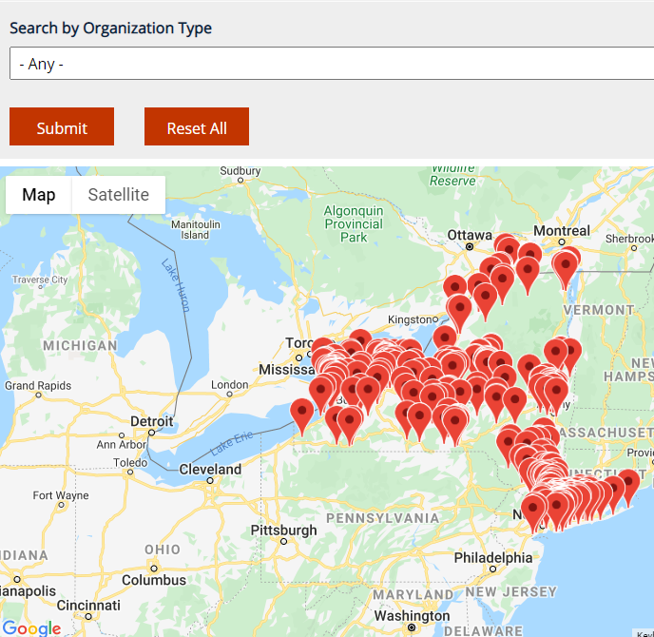
NYSED Statewide Science Resource Network
Notes:
NYSED Statewide Science Education Network UPDATED
The Office on Curriculum and Instruction just updated its NYSED State-Wide Science Resource Network resource which can support local, regional, and statewide science education/educator efforts:
The PDF houses a power-point that lists national and state science resources with live links.
Teachers of science at all levels can explore and access science resources available across the state and in different regions, and localities.
Specific regions across New York State have been identified and include valuable science sites and resources for educators and parents to help with the implementation of the New York State P-12 Science Learning Standards.
An interactive map has also been created to find resources close to your location. Listed on the site is:
New York State Teacher Centers
BOCES centers
New York State Department of Environmental Conservation: Environmental Education Centers
New York State Department of Environmental Conservation: Parks, Recreation, and Historic Preservation Centers
New York State Master Teacher Program sites
New York State STEM Hubs
STEM Ecosystems
STANYS (Science Teachers Association of New York State) Regions
Public Broadcasting System (PBS) Learning Media Centers/Locations

Slide 18
SCIENCE High School Course Maps
Aligned to new Regents examinations in science
Aligned to the New York State P-12 Science Learning Standards
Includes:
Earth and Space Sciences
Life Sciences: Biology
Physical Sciences: Chemistry
Physical Sciences: Physics
Notes:
HIGH SCHOOL SCIENCE COURSE MAPS
To support the urgency of transforming HS science classrooms through a combination of three-dimensional lessons to meet the expectation of the new HS science learning standards the Department developed 4 HS Science course Maps aligned to NYSP-12SLS and aligned to new Regents Science Examinations
These maps are available for Earth and Spaces Sciences, Life Sciences-Biology, Physical Sciences-Chemistry and Physical Sciences–Physics.
The purpose of these maps is to assist teachers, local school districts, and professional developers, among other stakeholders in the transition process by building course curriculum programming and shifting instructional practices. Professional Development can center around new curriculum programming and instructional shifts as new courses are developed. Each Science Course map is a 10-page document that provides information to educators about the architecture of the standards and includes specific guidance on recommended performance expectations, for curriculum development/programming and instruction.

Slide 19
NYSED Webpages Relevant To Science Education
Notes:
NYSED Webpages Relevant to Science Education
CLICK
Recently NYSED has created a new page called NYSED Webpages Relevant to Science Education. This webpage houses links to science resources from other offices within the New York State Education Department. We hope this will help provide a connection to other NYSED offices that support science and the NYSSLS.

Slide 20
Statewide Science Update
Notes:
To support educators and administrators with the implementation of the New York State P-12 Science Learning Standards, the Office of Standards and Instruction hosted a free, one-hour webcast, titled “NYSED Statewide Science Update.”
Within this webcast, I presented and reviewed existing materials and resources designed for the standards transition. The free one-hour webcast is intended for and available to New York State PK-12 science teachers and administrators and was held on Wednesday, March 16th, 2022, at 4:00pm. The presentation was recorded and will be posted on the NYSED science page very soon.
The presentation will be recorded and published on the Office of Curriculum and Instruction’s Science page for the educators who are not able to attend.

Slide 21
PAEMST
2022-2023 PAEMST Award Cycle
7-12th grade educators
Nominations open:
Fall 2022
Please visit www.paemst.org for more information.
Notes:
I would like to now talk to you about the awards and scholarships the Office of Standards and Instruction office oversees.
PAEMST (1 of 3)
The Presidential Awards for Excellence in Mathematics and Science Teaching (PAEMST) program was established in 1983 by The White House and is sponsored by the National Science Foundation (NSF). Each year the President of the United States recognizes outstanding teachers in mathematics and science (including computer science) from across the nation at the Kindergarten through 6th grade level or 7th through 12th grade level and bestows upon them the Presidential Awards for Excellence in Mathematics and Science Teaching (PAEMST). The President may recognize over 100 exemplary teachers each year.
The 2022-2023 PAEMST program will be accepting nominations for eligible exemplary mathematics and science (including computer science) 7-12 grade teachers for this award in Fall 2022. New York State is looking for nominations of outstanding mathematics and science teachers that spark students’ imaginations in STEM education through innovative teaching and learning.
Annually, New York State can recognize up to three Mathematics finalists and three Science finalists. The New York State PAEMST finalists’ applications are forwarded to a PAEMST Review and Selection Committee at the National level. Of the State finalists in Mathematics and Science, up to two finalists in mathematics or science from each state will be recognized at the National level.
For more information pertaining to the 2022-2023 nomination and application process visit the PAEMST website or e-mail info@PAEMST.org
The application consists of three components: Administrative, Narrative, and Video.
The application is designed to allow the applicant to provide evidence of deep content knowledge and exemplary pedagogical skills that result in improved student learning. After eligibility is confirmed and technical specifications are met, each application will be evaluated using the following five Dimensions of Outstanding Teaching:
Mastery of content appropriate to grade level taught.
Use of effective instructional methods and strategies that are appropriate for the students in the classroom and that support student learning.
Effective use of student assessments to evaluate, monitor, and improve student learning.
Reflective practice and life-long learning to improve teaching and student learning.
Leadership in education inside and outside the classroom.

Slide 22
NYSED Science Email
Please send questions regarding the NYSP12SLS to
ScienceStandards@nysed.gov
Notes:
NYSED Science Email
If you have question about science curriculum or the NYSP-12SLS please utilize our science specific mailbox. Please send question regarding science to ScienceStandards@nysed.gov.

Slide 23
NYSED Office of Standards & Instruction (518) 474-5922 www.nysed.gov/curriculum-instruction Nicole Marschilok Associate in Instructional Services - Science Nicole.Marschilok@nysed.gov
Notes:
Closing
Thank you for your time and attention today. Our office very excited about the new resources released and ask for your help in spreading the word.

