Slide 1
March 7, 2019
Creating a Relationship Centered Classroom Through SEL Practices
Christine Merle
cmerle@childrensinstitute.net

Slide 2
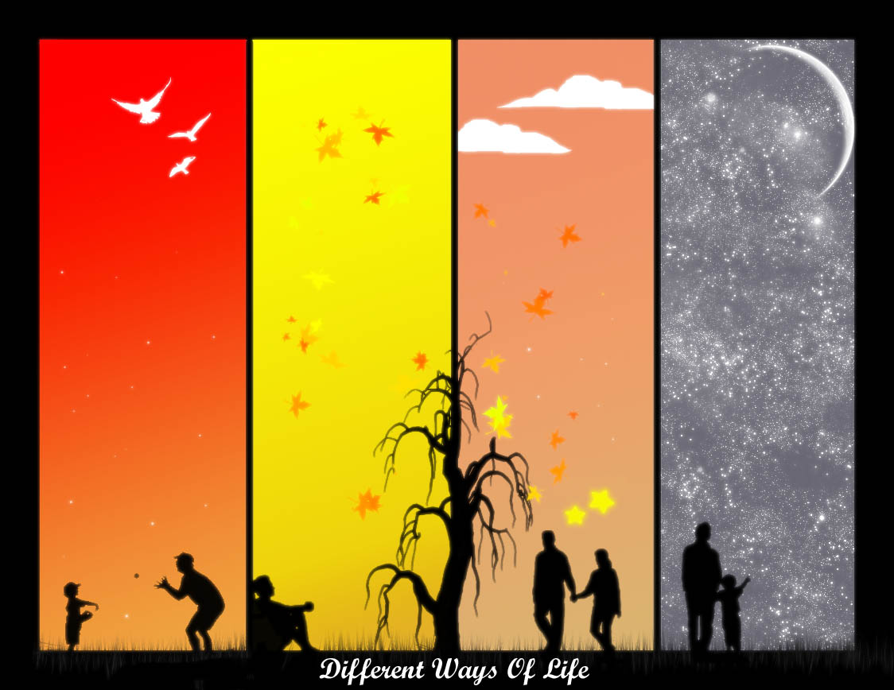
Introductions
What makes your school
“DIFFERENT”?

Slide 3
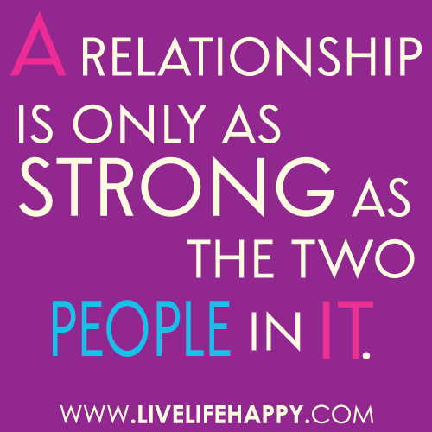
Objectives for Today
Review Social Emotional Learning definition, the brain connection and the 5 competencies
Review practices that promote SEL and prioritize them for yourself
Focus on 3 practices that can change social emotional development in classrooms.

Slide 4
Think-Pair-Share What strengths, skills or attributes do you want the kids at your school to acquire by the time they graduate from high school? What do you hope that they will contribute to society?

Slide 5
What is SEL?
A process through which children and adults gain and apply knowledge, attitudes, and skills to:
Understand and manage emotions
Set and achieve positive goals
Feel and show empathy for others
Establish and maintain positive relationships
Make responsible decisions

Slide 6
SEL is Developmental
Self-Management Skills
Grade 12
More sophisticated use of strategies. Begin to seek help as needed
30’s – 50’s
Exploring self-management in relation to others (e.g., coupling, cohabitating, parenting)
Kindergarten
Identify feelings and emotions
Grade 5
Begin to use strategies to manage emotions and be self-reflective
Early 20’s/College/First Job
Understand impact on others
Reliance on self vs. parents, caregivers and teachers
60’s and beyond
Coping with life changes (e.g., aging), reemergence of relying on others

Slide 7
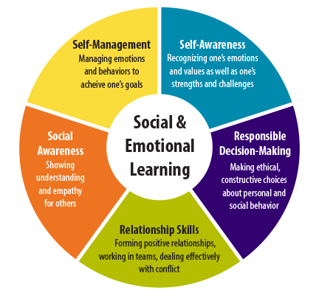
Core Social and Emotional Competencies
Notes:
Every child, and adult for that matter, needs a set of social and emotional competencies that provide them with a foundation for success. The Collaborative for Academic, Social, and Emotional Learning has defined 5 core social and emotional competencies that they think every child (regardless of race, ethnicity, socio-economic status, or mental health capacity) needs for success.
We are talking here about the skills to recognize and manage one’s emotions, to interact well with others and form relationships, to be empathetic and understand other people’s perspectives, to make good decisions. These are skills that will help every child to become a successful adult. So it is important to focus on this point – that SEL is for all children
These skills can be taught. And they are learned within the context of the classroom (curriculum and instruction), the school (policies and practices) and community and family.

Slide 8
Kids are Kids!!
5%
10%
15%
20%
80%
70%

Slide 9
What difference does SEL make?
2011 Meta-analysis by Durlak, Weissberg, et al.
11 percentile point gain in academic achievement
Improved Classroom Behavior
Increased ability to manage stress and depression
Better attitudes about themselves, others & school
If that is true, what are the barriers?

Slide 10
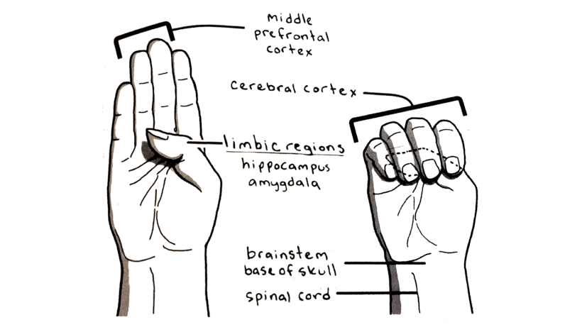
“Flipping Your Lid”

Slide 11
5 Competency Sort
Which competency feels most comfortable for you? Least comfortable for you?
Think about your students – which competency are they strongest in? Which competency do they need the most support?

Slide 12
What Does SEL Look Like in Schools?
Explicit instruction
Classroom practices
Schoolwide practices
Changes in policy and procedure
Notes:
Four ways SEL happens in schools
Explicit instruction means set aside time or lessons to explore specific competencies – Second Step is a good example. This is explicit teaching of SE skills
Schoolwide practices are where interactions happen between adults and students outside the classroom. This might include things like a new conflict resolution strategy for the playground, monthly themes reinforced through assemblies, bulletin boards and morning announcements, buddy programs, service learning projects, and others
Classroom practices are the ways you can infuse SEL into your classroom throughout the day, throughout your lessons, without doing anything extra. This could be as simple as authentically greeting each child when they come in the door, or creating a calm down corner for students to go regroup if they get upset. It might be incorporating reflection into your group work activities so students can process what worked well and what didn’t. Etc.
Finally, changes in policy and procedure complete the picture and often take longer – this might be things like revising your code of conduct to reflect more positive language about expectations rather than a list of rules and punishments. It might mean changing job descriptions or hiring practices to ensure incoming staff have the skill set you are looking for. It might be changing the homework policies.
In schools that do this well, they do all 4. But most start with one and work their way up. This takes 3-5 years.

Slide 13
Practices that Promote SEL
Look through them as a table – try to prioritize them.
Which do you see consistently being used? Which ones do you sometimes see? Which do you never observe?

Slide 14
Visible Learning -
John Hattie

Slide 15
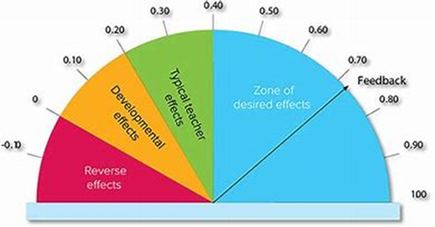

Slide 16
Teacher Language
Feedback = .73
Student Centered Discipline
Classroom Management = .52

Slide 17
Responsibility and Choice
Creativity Projects = .65
Warmth & Support
Teacher Student Relationships = .72
Classroom Cohesion = .53
Peer influences = .53

Slide 18
Cooperative Learning
.41
Small Group Learning = .49
Self Reflection & Self Assessment
Self reporting grades = 1.44
Self verbalizing or self-questioning = .64

Slide 19
Balanced Instruction
Direct instruction = .59
Small Group Learning = .49
Reciprocal teaching = .74
Cooperative Learning = .41
Academic Press & Expectations
Teacher Expectations = .43
Not Labeling Students = .61

Slide 20
Competence Building
Social Skills Programs = .40
Worked examples = .57
Classroom Discussion
.82

Slide 21
Factors that Impact Relationship-Centered Classrooms
Greeting – Welcoming Students with a Smile
Warmth & Support
Teacher Language

Slide 22
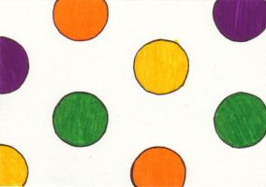
Factors that Impact Relationship- Centered Classrooms
Getting to Know You
The Dot Project

Slide 23
Factors that Impact Relationship-Centered Classrooms
STUDENT CHOICE

Slide 24
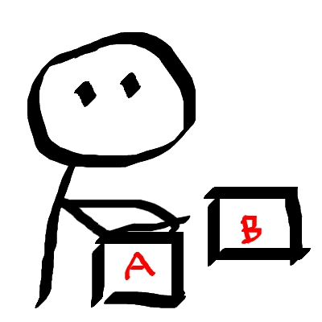
How we deliver choice matters
You may choose to ___________ or _____________.
Which do you choose?
Make sure that either choice gets the job done.
Make sure that you can live with either choice.
Wait for response.
Reinforce the CHOICE.
End with a “thank you”.

Slide 25
Choice:
Grouping Students
Sequencing of Activities
Differentiation
Content
Process
Product

Slide 26
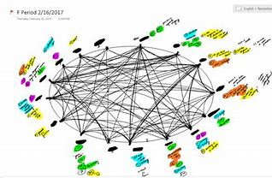
Factors that Impact Relationship-Centered Classrooms
Discussion Strategies - Visible Learning John Hattie .82
Inner/Outer Circle
Back to Back/Front to Front
Socratic Seminar/Fishbowl
Discussion Mapping
Notes:
The good news is that social and emotional competencies can be taught and we have research to back up the value of taking time to foster these skills. A variety of studies have been done on SEL, but the biggest one was a meta-analysis or a study of studies, that looked at 288,000 kids across 207 studies.
Found all these things happened. One key thing is that behavior improved and schools implementing this had fewer disciplinary incidents. So spending time focused on teaching these skills, even though it is time away from academics, is worth it. Because you already spend time on addressing behavior. This is just a more proactive way to address behavior rather than dealing with problems.
There is also research showing that focusing on SEL helps reduce staff stress and fatigue – partly because it helps with the behavior problems that can take such a tool
Improved SE competencies has been connected to better school connectedness, less need for pull out or restrictive placements, and also less engagement in risky behaviors later in life – so kids who had high SE skills in kindergarten were less likely to abuse drugs and alcohol as adults or be involved in the criminal justice system.
And then finally, researchers were a little bit surprised to find that SEL improved academic achievement. But of course, if you have children in front of you who are calm, who have problem solving skills, who can identify how they are feeling, you have more time to teach and they are better able to learn – going back to those brain slides, they can literally think better when they have these skills.

Slide 27
Your Closure for Today!!
When I think about what makes my school “different”, what did I learn today that could enrich and support that difference?

Slide 28
Thank you for your attention and participation!
Please don’t hesitate to contact us if we can support your work in any way.
Christine Merle cmerle@childrensinstitute.net
585-295-1000X281

