Slide 1
NYSCSS
NYSED Update
Christine Radez
Social Studies Associate
Office of Curriculum and Instruction
Christine.Radez@nysed.gov
Lisa Pingelski
Social Studies Associate
Office of Assessment/Office of Curriculum and Instruction
Lisa.Pingelski@nysed.gov

Slide 2
Social Studies Through the Lens of the ESSA plan

Slide 3
NYS Board of Regents Mission Statement
“The mission of the New York State Board of Regents is to ensure that every child has equitable access to the highest quality educational opportunities, services and supports in schools that provide effective instruction aligned to the state’s standards, as well as positive learning environments so that each child is prepared for success in college, career, and citizenship.” (Page 6)

Slide 4
Social Studies and the ESSA Plan
“Of the 19 states and the District of Columbia that have sent in their state plans for peer review; 11 states and D.C. have included civics in their ESSA state plans. When looking at examples from the ESSA state plans, New York showed a strong commitment to civic education with the creation of the College, Career and Civic Readiness Index in their ESSA state plan. The plan will focus on civic engagement as a part of a more holistic approach to accountability.”
The Council of State Governments, “Federal Education Policy Opens Door to Civic Engagement” 7-8/2017
  https://www.csg.org/pubs/capitolideas/2017_july_aug/civics_essa.aspx

Slide 5
New York Includes Accountability Measures For Social Studies
Accountability measure guidelines:
Academic Achievement” MUST be reading and math test scores. It cannot be Science or Social Studies test scores.
“Academic Indicator of school quality or student success” States have some flexibility. Growth on reading and math, closing achievement gaps, science scores and social studies scores maybe by included.
    Delaware and New York State
“Indicator of school quality or student success” States have a lot of flexibility. Chronic absenteeism, school climate, physical education, science and social studies scores may be included.
    Delaware, New York, Florida, Texas, Louisiana
“Approved ESSA Plans: Explainer and Key Takeaways From Each State”, Education Week 10/4/2018
https://www.edweek.org/ew/section/multimedia/key-takeaways-state-essa-plans.html

Slide 6
To that end, the Regents and Department of Education seek to address the following goals in this ESSA plan:
Build an accountability and support system that is based upon multiple measures of college, career, and civic readiness.
Provide all students access to extra-curricular opportunities so that students
can serve their schools and their communities, participate in community-based internships, and engage in sports and arts.
Promote a relationship of trust, cultural responsiveness, and respect between schools and families, recognizing that student achievement and school improvement are shared responsibilities.
Provide educators with opportunities for continual professional development in the areas of equity, anti-bias, multicultural, and culturally responsive pedagogies.
Support districts and their communities in engaging in critical conversations about culturally responsive educational systems.
(Page 6)

Slide 7

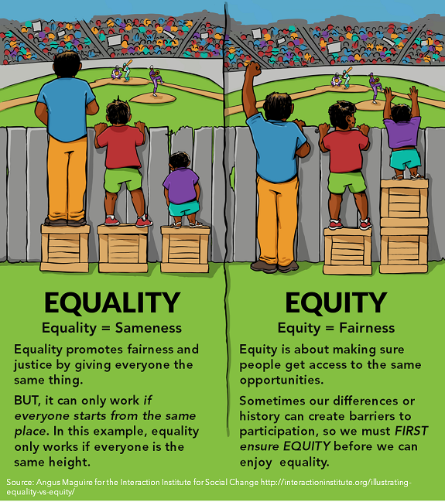
Every Student Succeeds Act and Social Studies
Social Emotional Learning
Culturally Responsiveness
Civic Readiness
Definition of Social Studies from the National Council for Social Studies
The primary purpose of social studies is to help young people make informed and reasoned decisions for the public good as citizens of a culturally diverse, democratic society in an interdependent world.
This Photo by Unknown Author is licensed under CC BY-NC

Slide 8
Social Emotional Learning Benchmarks
Develop self-awareness and self-management skills essential to success in school and in life
Use social awareness and interpersonal skills to establish and maintain positive relationships
Demonstrate ethical decision-making skills and responsible behaviors in personal, school and community contexts

Slide 9
THE NYS SOCIAL STUDIES FRAMEWORK SUPPORTS SEL
NYS Social Studies Framework
Practice of Civic Participation
Social Emotional Five Core Competencies
Demonstrate respect for the rights of other in discussions
Participate in activities that focus on a classroom, school or community problem
Show respect in issues involving difference and conflict
Identify social and political responsibilities at the classroom, school and community level

Slide 10
Culturally Responsive
Framework
Help educators create student-centered learning environments that:
1. Affirm racial, linguistic and cultural identities
2. Prepare students’ abilities to connect across lines of difference
3. Elevate historically marginalized voices; empower students as agents
of social change

Slide 11
THE NYS SOCIAL STUDIES FRAMEWORK SUPPORTS THE CULTURALLY RESPONSIVE SUSTAINING EDUCATION FRAMEWORK
Kindergarten- K.2 Children, families, and communities exhibit cultural similarities and differences
2nd Grade- 2.2b A community is strengthened by the diversity of its members, with ideas, talents, perspectives and cultures that can be shared across the community
3rd grade- 3.4 Each community or culture has a unique history, including heroic figures, traditions and holidays 3.4b Arts, music, dance and literature develop through a community’s history

Slide 12
The Civic Readiness Initiative
NYSCSS Board of Directors who serve as Task Force Members and CAP members
  Laura Mecca-Retzlaff, President NYSCSS
  April Francis, Vice President NYSCSS
  Lisa Kissinger, President NYS4A
  Joe Karb, Curriculum and Assessment Committee Co-Chairperson
  Thank you!

Slide 13
Civic Readiness in the Social Studies Framework (Excerpts)
K.4a #1 Students will identify basic rights they have (e.g., provision of food, clothing, shelter, and education, and protection from abuse, bullying, neglect, exploitation, and discrimination).
2.3c #2Students will participate in voting within the classroom and in school, as appropriate.
2.4c Students will explore opportunities to provide service to their school community and the community at large (e.g., beautifying school grounds, writing thank-you notes to helpers).
4.4e #2 Students will discuss active citizenship and adults’ responsibility to vote, to understand important issues and to serve on a jury
7.5b #3 Students will identify the individual rights of citizens that are protected by the Bill of Rights.
7.7a Students will investigate examples of early 19th century reform movements, such as education, prisons, temperance, and mental health care, and examine the circumstances that led to the need for reform
8.9b #1 Students will examine struggles for equality and factors that enabled or limited success on behalf of women, farm workers, Native Americans, the disabled and the LGBT community
`

Slide 14
US History And Government Grade 11
11.10b Students will trace the following efforts in terms of issues/goals, key individuals and groups and successes/limitations
Brown Power (Chicano movement) e.g., Cesar Chavez, United Farm Workers
Student rights (e.g., Engel V. Vitale (1962), Tinker V. Des Moines SD (1969), NJ V. TLO
(1985)
11.11b #3 Students will evaluate the USA Patriot Act, including constitutional issues raised about the violation of civil liberties by the federal government’s electronic surveillance programs
PART 3 U.S. Framework Based Regents Exam: CIVIC LITERACY ESSAY
6 documents representing a constitutional crisis or civic issue in American history
Student identify the issue and explain the historical context, efforts made to address the issue and the extent to which the efforts were successful.

Slide 15
Participation in Government
Mandatory Graduation Requirement for all NYS Students
Grade 12: Participation in Government and Civics This course aims to provide students with opportunities to become engaged in the political process by acquiring the knowledge and practicing the skills necessary for active citizenship. Content specifications are not included, so that the course can adapt to present local, national, and global circumstances, allowing teachers to select flexibly from current events to illuminate key ideas and conceptual understandings. Participation in government and in our communities is fundamental to the success of American democracy.
12.G2a Equality before the law and due process are two fundamental values that apply to all under the jurisdiction of the United States. While the United States legal system aims to uphold the values of equality before the law, due process, human dignity, freedom of conscience, inalienable rights, and civility, the extent to which the legal system upholds these values in practice is an issue of ongoing civic debate.
12.G4e Citizens participate in civic life through volunteerism and advocacy, including efforts such as contacting elected
officials, signing/organizing petitions, protesting, canvassing, and participating in/organizing boycotts.

Slide 16
#1 Defining Civic Readiness
Co-Facilitators Steve LaMorte, Department Chairperson of Rochester City Schools and David Scott, Project Patch Coordinator, Northport Schools
New York State is committed to equity by empowering all students to make informed decisions for the public good as members of a culturally diverse, democratic society.
Individuals must acquire and demonstrate knowledge, skills, dispositions, and actions that are needed to fulfill the rights and responsibilities within their communities, states, our country and the world.

Slide 17
#2 Recognition of Civic Readiness at the District Level
Facilitator, Chris Sperry, Teacher at Lehman Alternative Community School, Ithaca, NY
Six Proven Practices in Civic Education
  1. Discuss the current issues that are important to young people
  2. Link community service to classroom instruction
  3. Get students involved in their schools and communities
  4. Encourage participation in school governance
  5. Encourage stimulations of democratic processes (ex. Restorative justice)
  6. Provide instruction in government, history, law and democracy

Slide 18
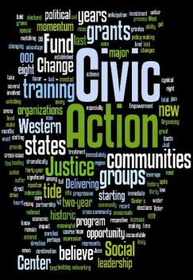
#3 Civics Capstone and Portfolio Based Assessments
Facilitator, Lisa Kissinger, 6-12 Department Chair at Shenendehowa, Clifton Park
Discussing resources that could be provided to schools to implement K-12 Portfolio Based Assessments
Creating a rubric for a model capstone project that could be an optional criteria in the Seal of Civic Readiness

Slide 19
#4 Seal of Civic Readiness for
NYS HS Diplomas
Facilitator, Dawn Bartz, Department Chair at Yonkers City School District
Write criteria for the Seal of Civic Readiness
The seal will include will include capstone projects and experiential learning as options for attaining the seal
The seal will count towards a school district’s index
The committee is considering recommending the seal become a +1 Civics Pathway

Slide 20
Update from the Social Studies Content Advisory Panel (CAP)
The CAP has been working with the Civic Readiness Task Force to provide feedback and expertise from the classroom educator perspective on the Civic Readiness initiative
The CAP is creating K-12 grade level resources that support the social studies practice of Civic Participation and Gathering, Interpreting and Using Evidence
  This includes rubrics for action civics projects for grades K-12
The CAP is also creating a K-4 coding system of skills comparable to the Math and ELA standards to give teachers the tools they need to meaningful incorporate social studies instruction into existing structures

Slide 21
ESSA Funding for Civics, History, Economics, and Geography
TITLE II:
A competitive grant program for non-profit organizations to run intensive, two to six week long academies in American history, civics and government for high school students and for teachers.
A competitive grant program for non-profit organizations to develop and disseminate innovative approaches to offering high quality instruction in American history, civics, government and geography for under-served students.
TITLE IV:
School Districts are required to use a certain percentage of their federal money on coursework that supports a well-rounded education. LEAs can choose from a list of subjects that specifically includes civics, history, economics, and geography, LEAs can partner with non-profits on this funding.
A research and innovation fund allows school districts, in conjunction with non-profit organizations, to apply for funding to create, implement, replicate, or take to scale entrepreneurial, evidence-based, field-initiated innovations to improve student achievement and attainment for high-need students. Innovations in teaching civics, history, and social studies are eligible for grants.

Slide 22
Social Studies Literacy
Initiatives Update
Disciplinary Literacy Toolkit
News Literacy Online Resource Guide

Slide 23
Literacy Standards in social studies Practices
Gathering and Interpreting Evidence
Comparison and Contextualization
Civic Participation

Slide 24
Examples of Task models that support news/media literacy skills in Part 1 of
US and Global
Students are given a stimulus and asked to identify point of view, purpose, context, bias, format of source, location of source in time and/or place, and/or intended audience of sources using background knowledge.
Students are given one stimulus or two stimuli and asked to identify a problem (issue)
Students are given a stimulus and asked to select a plausible claim that logically flows from evidence presented

Slide 25
Skills Assessed in Part 2 for Global II and U.S. that support news/media literacy skills
Bias
Point of view
Audience
Purpose

Slide 26
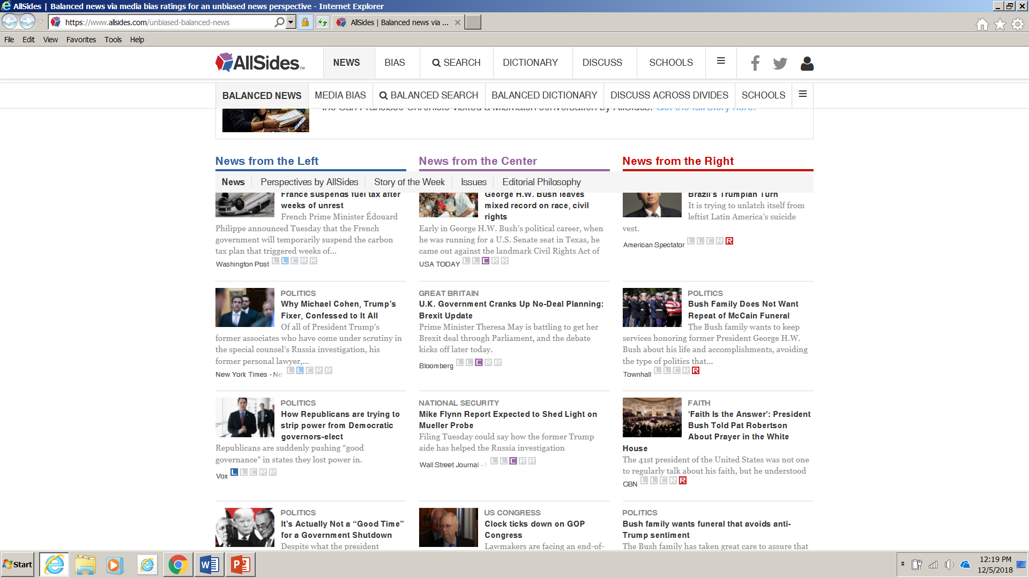
Current Event Resources
www.snopes.com
www.allsides.com

Slide 27
Stanford History Education Group
https://sheg.stanford.edu/civic-online-reasoning
Who's behind the information?
What's the evidence?
What do other sources say?

Slide 28
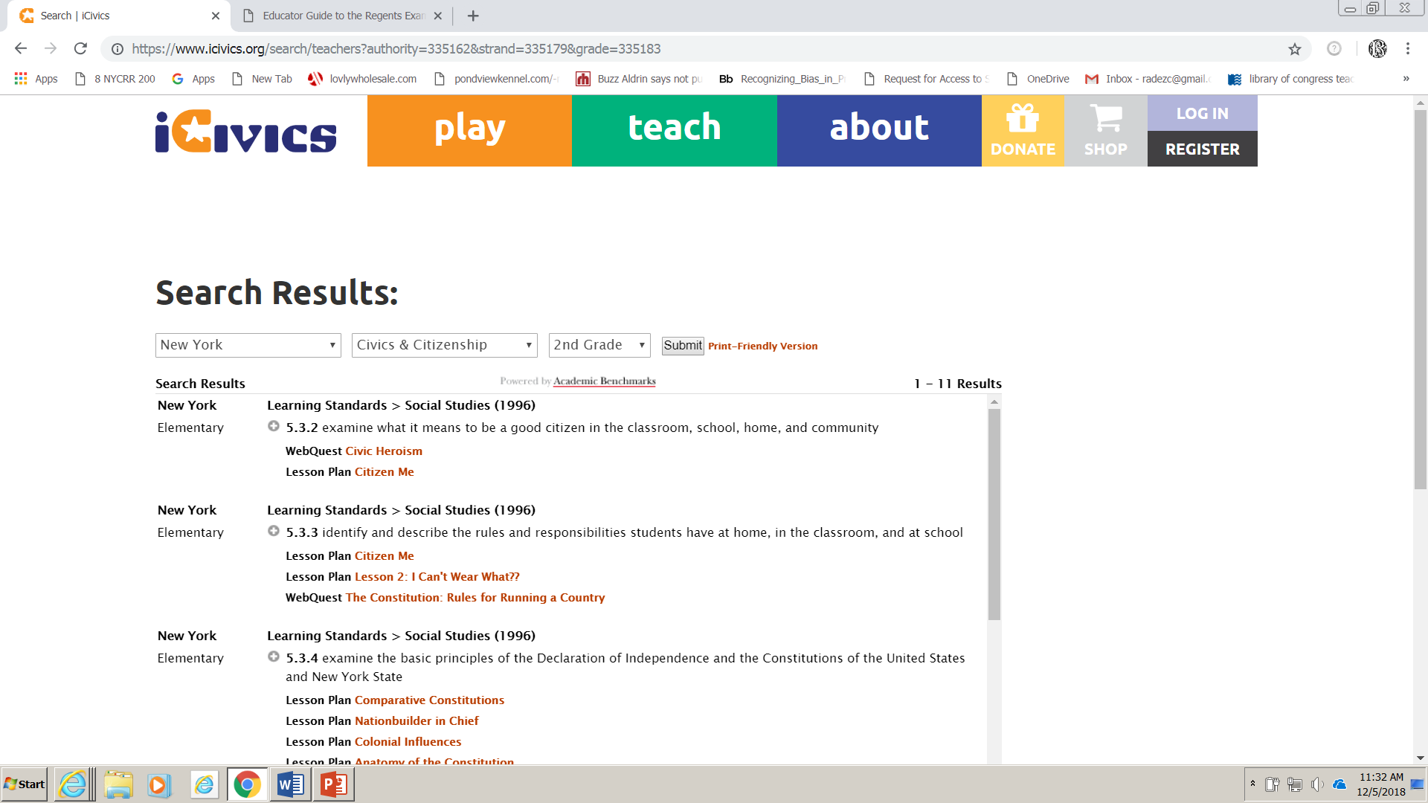
Icivics.Org Free Resource Created by Justice Sandra Day O’Connor
https://www.icivics.org/

Slide 29
Additional Resources
https://www.docsteach.org/ (U.S.)
http://avalon.law.yale.edu/subject_menus/ancient.asp (Global)
www.teachingtolerance.org

Slide 30

Questions, Comments,
Partnership Opportunities?
NYSED Office of Curriculum and Instruction
www.nysed.gov/curriculum-instruction
(518) 474-5922
EMSCURRIC@nysed.gov

